Slide 1
Rule based system VS Machine learning
Case study with Chess
Ilia Arkania

Slide 2
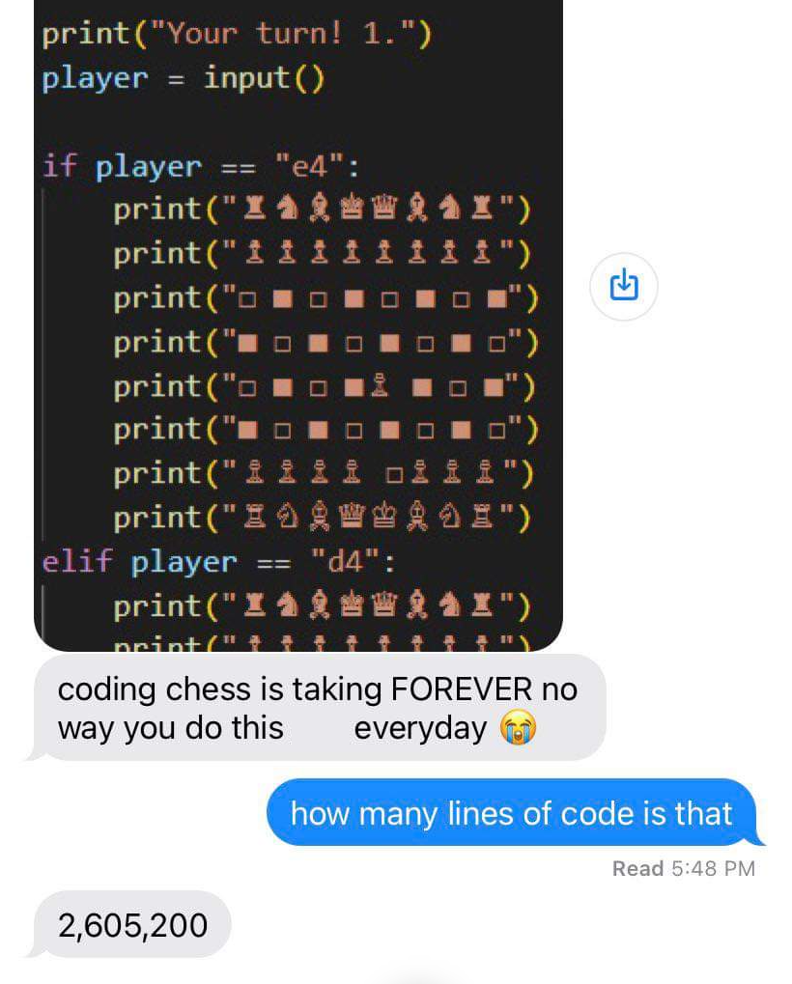
Rule based approach

Slide 3
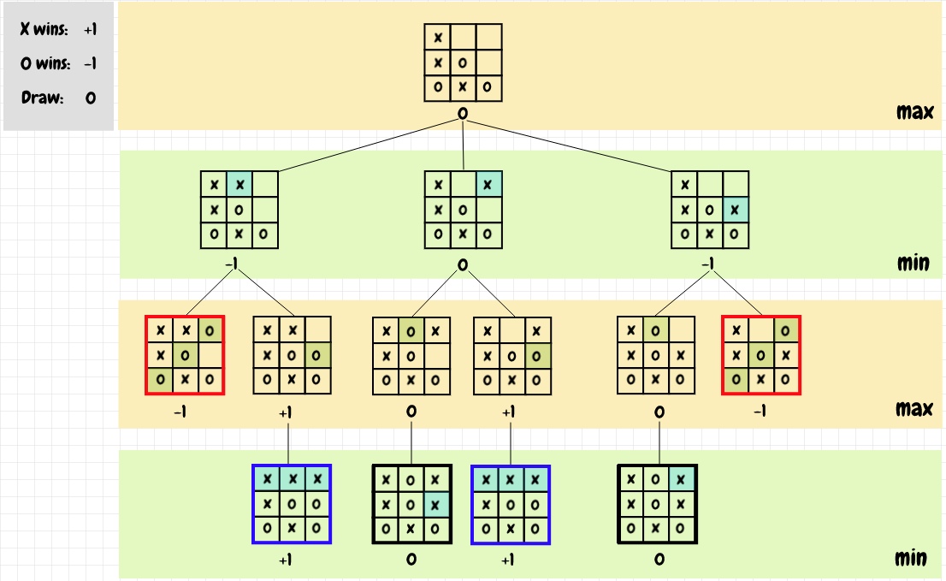
Realistic rule based approach
Minimax algorithm
If my opponent plays on “maximum” to win what do I have to do at “minimum” to end up in a good position
Deterministic algorithm
Difficult to adapt to changes
White box - we can see exact reasoning for each decision

Slide 4
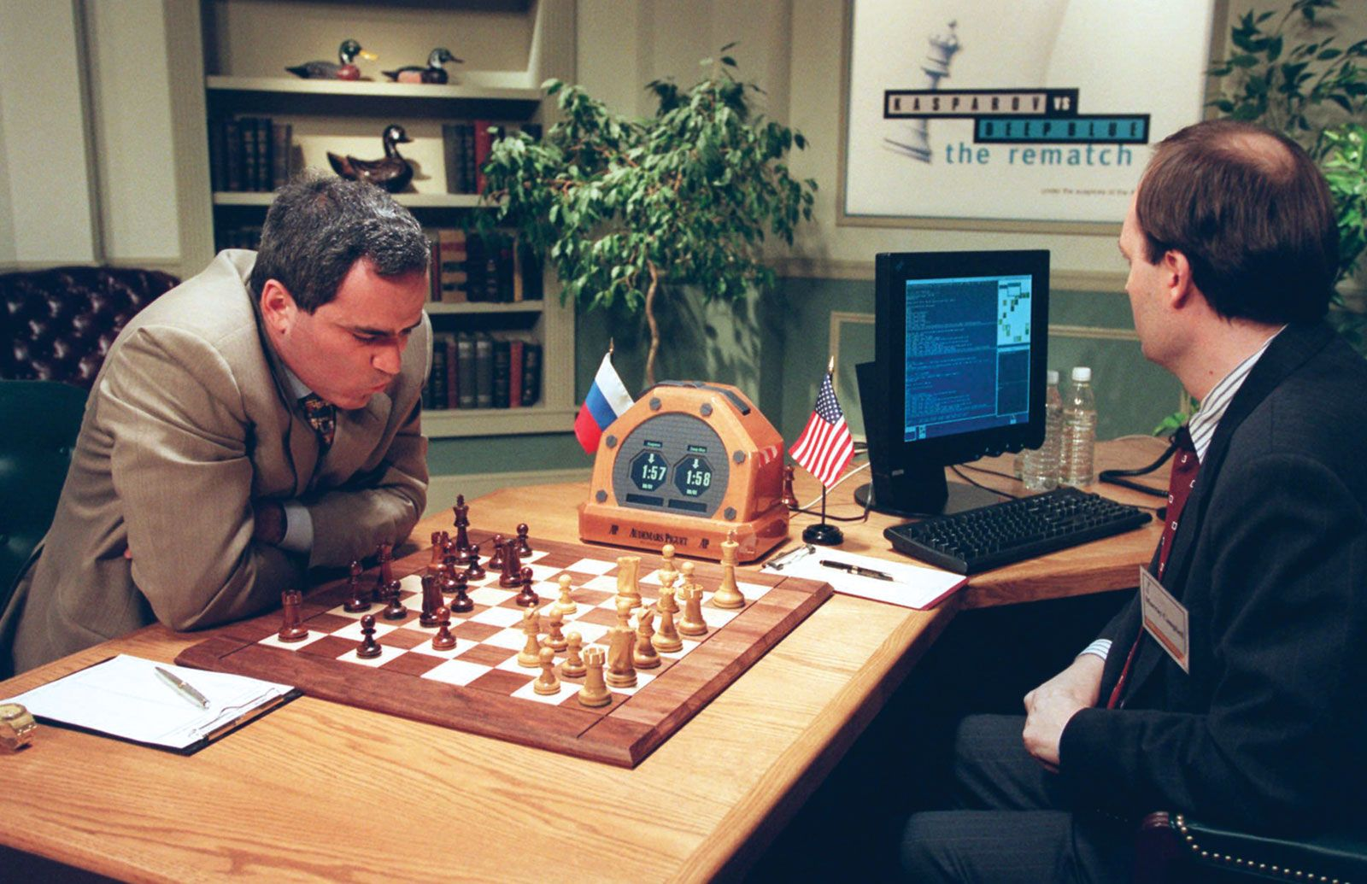
DeepBlue

Slide 5
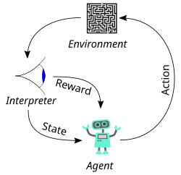
Machine learning approach
Supervised - It receives a giant dataset and checks for rewarding patterns
RL - It plays a ton of games itself and figures out most rewarding paths
Probabilistic algorithm
Highly adaptable - only needed retraining, base code stays the same
Black box - hard to see exact reasoning for each move, as logic is derived from weights
Requires way more resources

Slide 6

AlphaZero

Slide 7

Which is better?
Alpha-beta is intuitive and efficient
RL requires is more capable but requires more resources
In 2023 Stockfish ditched rule based evaluation system and transitioned to a fully NN-based approach

